Slide 1

GCIS-124
Software Development & Problem Solving
Course Intro

Slide 2
General Information
Course Title: GCIS-124 Software Development & Problem Solving II
Course Home Page
Schedule of Topics
Syllabus
Resources
MyCourses
Important Links & Resources
Instructor Office Hours/Contact Info
Course Materials / Quiz
Grades
GitHub Classroom
Assignments & Submissions
This course is required for students in several different majors within GCCIS including Software Engineering, Computing Security, Computing Exploration, and students in the iSchool.
Your instructor may be a member of any one of several different departments within the college. It does not matter which; all sections of the course are the same.

Slide 3
Grade Components
Each of these grade components will be discussed in detail over the course of the next several slides.
Component | % of Final Grade
Quizzes | 3%
Class Activities | 5%
Assignments | 12%
Mini-Practica | 5%
Midterm Exams | 54%
Final Exam | 21%
Software Development & Problem Solving is a course that is designed to be very hands on.
Because of this, most of your grade will be based on a practical application of the topics that you learn in class.
Class Activities
Homework Assignments
Mini Practica
Midterm Exams
Final Exam (includes a Practical)
You will be working on a computer for most of every class, during your exams, and when you work on your homework assignments.

Slide 4
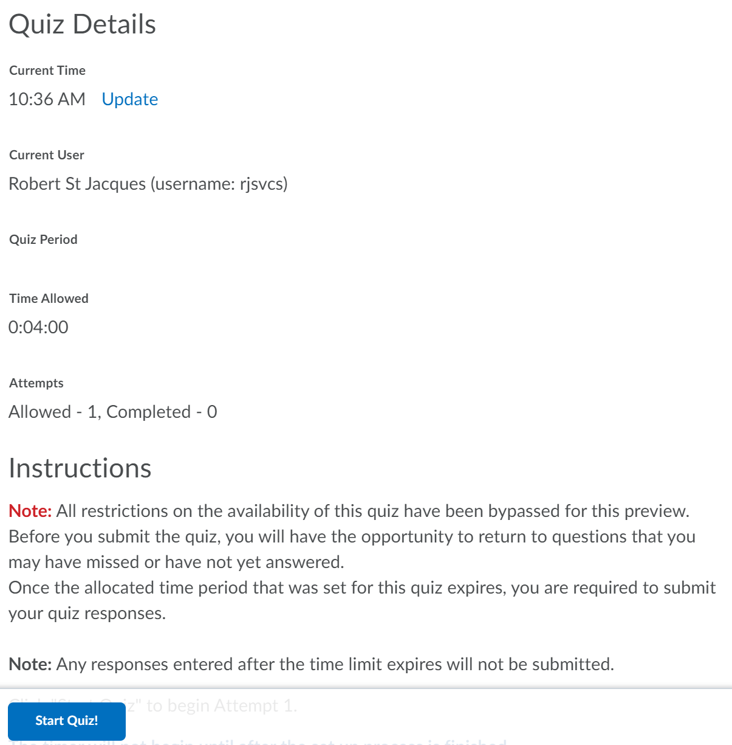
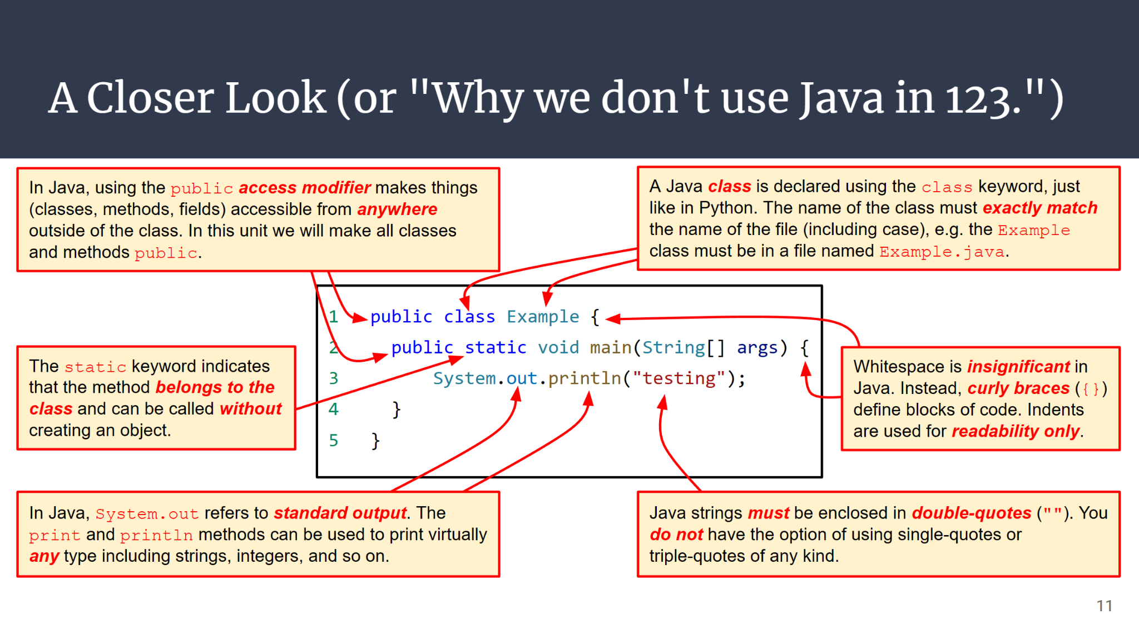
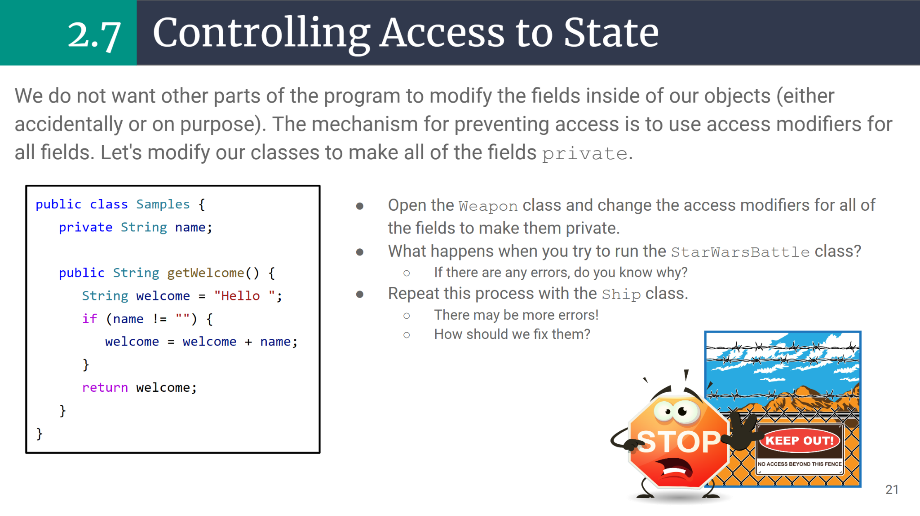
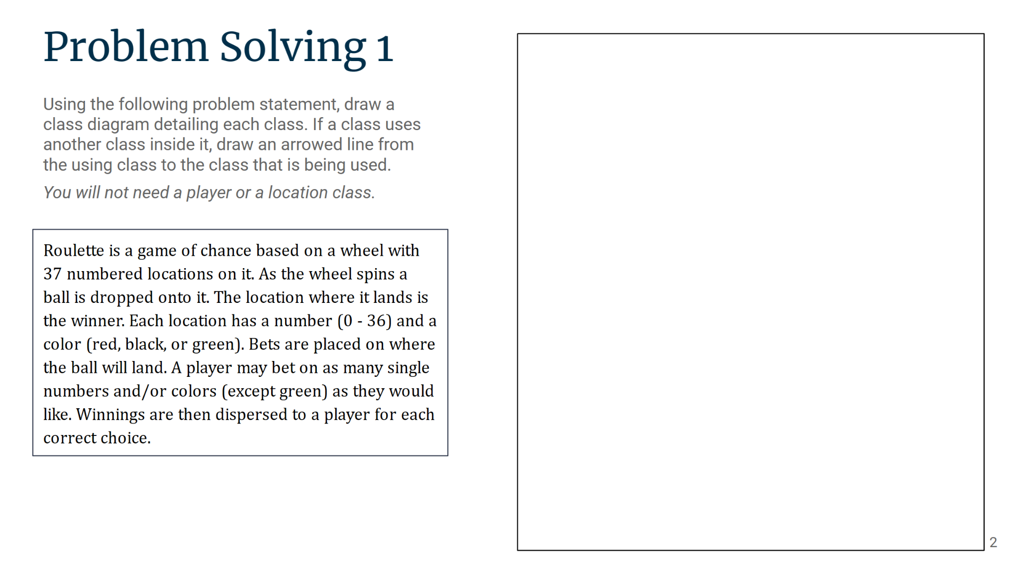
Class Sessions
During a typical week, some sections will meet for either two or three class sessions. Most will comprise some or all of the following:
A 5 minute quiz based on material from the previous lecture.
A 105 minute lecture covering one of the course topics and including several small coding activities for your to practice on a computer.
You may use your own computer or one of the computers provided for you in the classroom.
In any time remaining, you will begin your homework assignment, which is due before the start of the next class.

Slide 5
A Typical Unit (3 classes)
Here is a typical unit for GCIS-124 sections comprised of 3 classes.
DAY 1 | DAY 2 | DAY 3
Quiz 5 Minutes | Quiz 5 Minutes | Quiz 5 Minutes
Lecture & Activities 105 Minutes | Lecture & Activities 105 Minutes | Lecture & Activities 105 Minutes
Each class will begin with a quiz based on the previous day's lecture.
The remaining time will be divided between Lecture and In-Class activities.
There are also 3 Midterm Exams, each of which will include questions from about 3 units.

Slide 6
A Typical Unit (2 classes)
Here is a typical unit for GCIS-124 sections comprised of 2 classes.
DAY 1 | DAY 2
Quiz 5 Minutes | Quiz 5 Minutes
Lecture | Lecture
Each class will begin with a quiz based on the previous day's lecture.
The remaining time will be divided between Lecture and In-Class Activites.
There are also 3 Midterm Exams, each of which will include questions from about 3 units.

Slide 7
Quizzes
Most lectures will begin with a quiz.
Each quiz is designed to be completed in under 5 minutes and will comprise approximately 5 questions that are some combination of:
True/False
Multiple choice
Select all that apply
Ordering
Matching
Fill in the blank
There are some restrictions.
Each quiz will be password protected. Your instructor will reveal the password at the start of class.
Each quiz will only be available for the first few minutes of class.
If you miss a quiz, you will not get an opportunity to make it up.
Quizzes will count for 3% of your final grade.
John Q. Student (jqs2312)
The first thing you should do upon arriving in class is to log into MyCourses and take the daily quiz. Your instructor will give you the password.

Slide 8
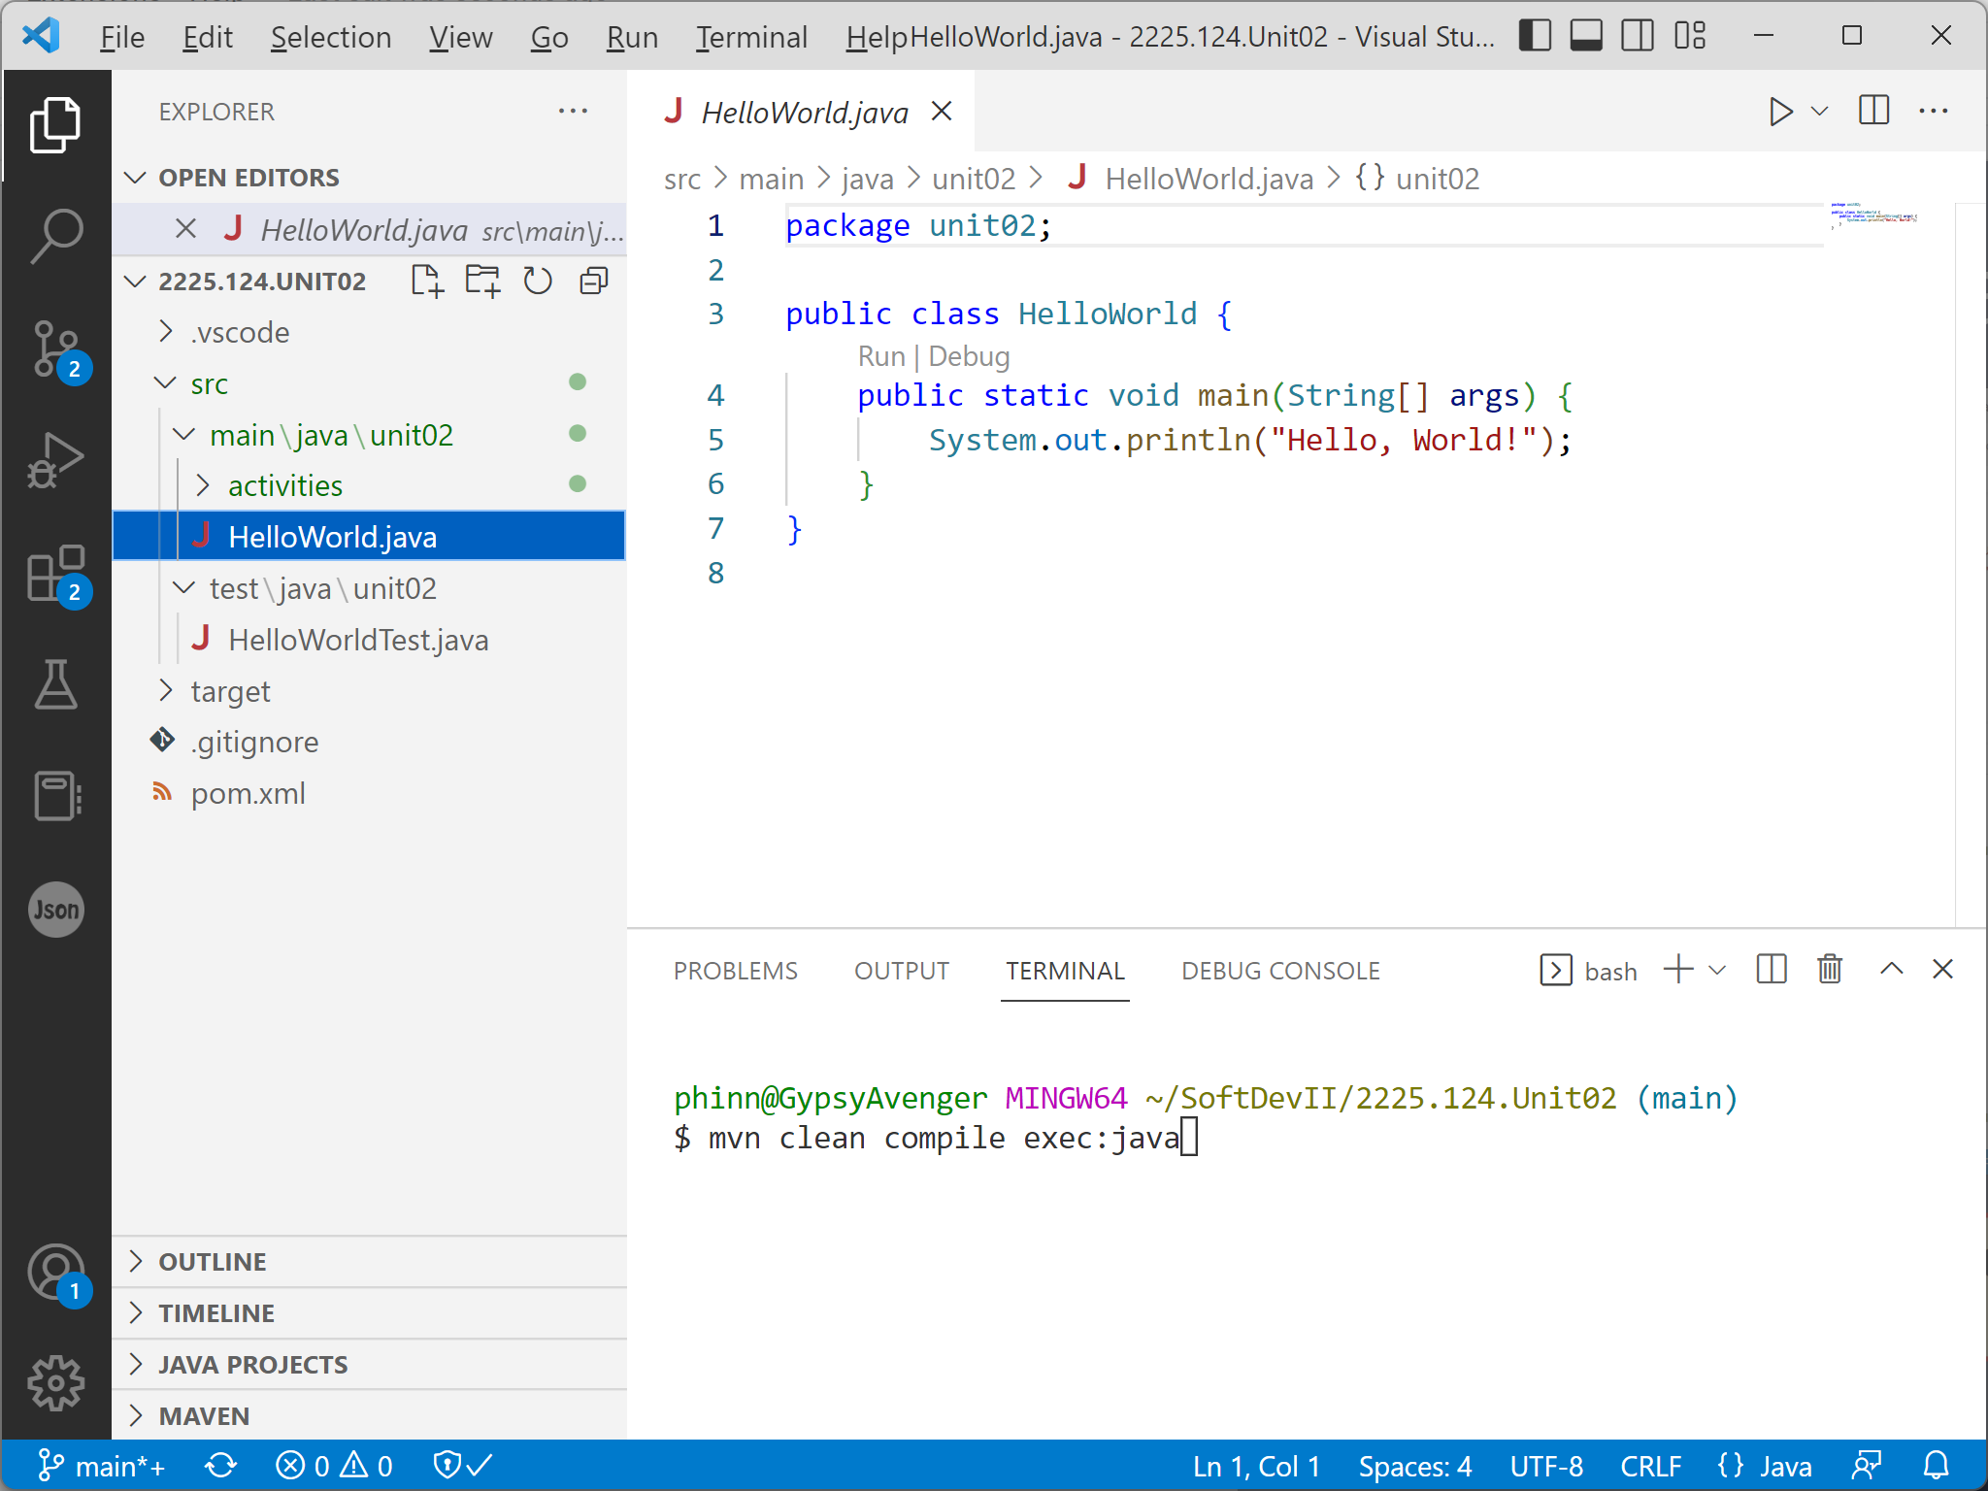
Mini-Practica
On the first day of each unit, you will take a Mini-Practicum.
The purpose of the mini-practica is to give you an opportunity to demonstrate practical application of the concepts that you learned in the previous unit.
There are some guidelines:
The instructions for each mini-practicum will be included in the repository that you create at the start of each unit.
Each will require you to demonstrate a practical application of your skills, usually by writing some code.
You will have 30 minutes to complete the mini-practicum.
If you miss a mini-practicum you will not be given an opportunity to make it up.
You will be graded on the solution that you have pushed at the end of the practicum.
Mini-Practica will count for 5% of your final grade.
Most Mini-Practica will require you to solve problems by writing code.

Slide 9
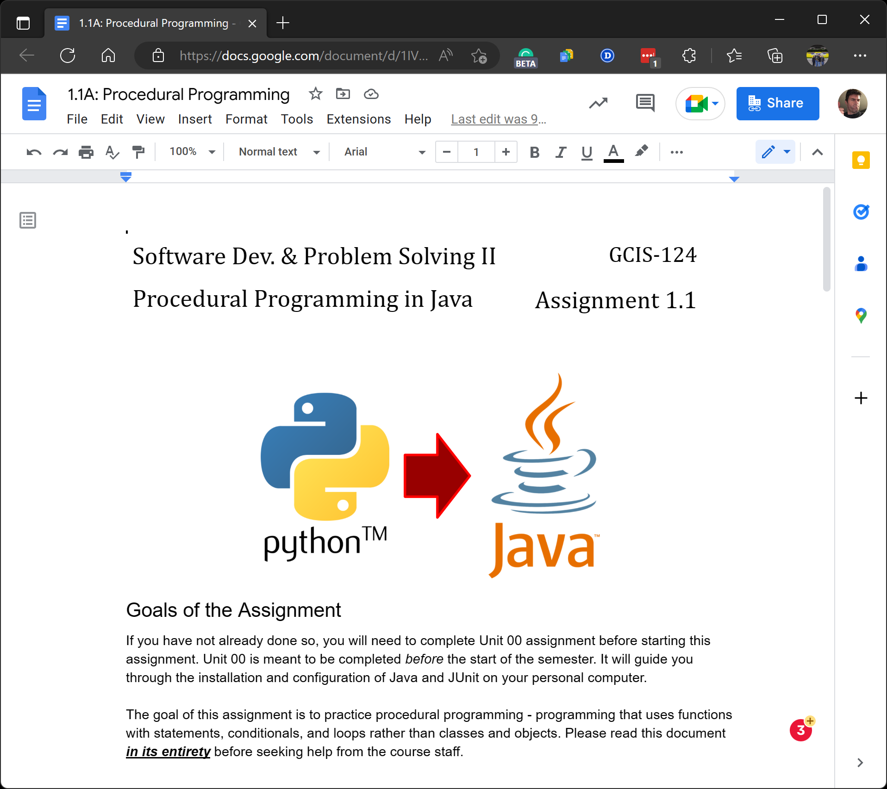
Homework Assignments
There will be a homework assignment assigned at the end of most class sessions.
The assignment will be due before the start of the next class, meaning that you will have 2-3 days to solve each assignment.
It is recommended that you start working on each assignment the same day that it is assigned, while it is still fresh in your mind.
This will give you an opportunity to seek help from your instructor or the Course Assistants before the assignment is due!
Each assignment will give you the opportunity to practice what you learned in the lecture to solve problems that are significantly larger and more complex than the class activities.
It's a good idea to review the lecture and practice the class activities before trying the homework!
Homework assignments will count for 12% of your final grade.
If there is time left at the end of class, you will be asked to get started on the homework. This is an opportunity to ask questions!
Notes:
Talk about last semester approach
Skill building and Assignment

Slide 10
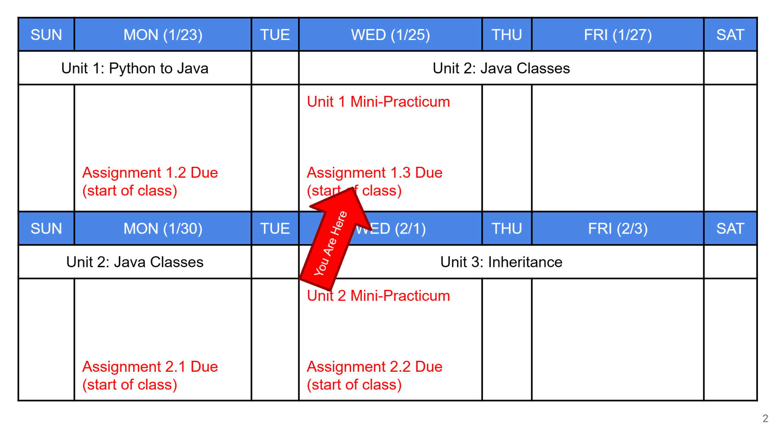
Lectures
Immediately following the daily quiz and/or mini-practicum, your instructor will begin each day’s lecture.
Each lecture comprises a mix of schedule reminders, new topics, and active learning activities.
Reminders include your weekly schedule, upcoming topics, assignments deadlines, exams, and other important dates and times.
Topics include new computing topics and examples.
These are presented 5-10 minutes at a time.
Active Learning Activities are your opportunity to immediately practice the concepts that you have just learned.
You’ll spend a few minutes on each activity.
Your instructor and the course assistants will be there to help if you have questions. Raise your hand!
Your instructor will go over the solution with the class.
Class activities will count for 5% of your final grade.
Each lecture will be provided through the course web site. Your instructor may or may not present directly from these materials.

Slide 11
Assignment Rubric
Exceptional Performance | Competent Performance | Acceptable Performance | Developing Performance | Beginning Performance | Needs Improvement | Unacceptable Performance
6 (100%) | 5 (95%) | 4 (88%) | 3 (75%) | 2 (50%) | 1 (25%) | 0 (0%)
The solution is complete and correct. Instructions were followed completely. or The student made a small number of minor errors for the first time, e.g. wrongly named files, output that does not match specifications, etc. A warning should be issued regarding any errors. | The solution is functionally complete other than a small number of functional errors. Instructions were followed completely. or The solution is completely correct but the student made a small number of errors that they have made at least once before, e.g. wrongly named files, output that does not match specifications, etc. An explanation should be issued regarding any of these errors. Instructions were followed completely. | The solution includes at least 80% of the required functionality and all instructions have been followed. or The student's effort is obvious based on the volume of work and commit history, but there are a modest number of errors that range from relatively minor to significant that can be easily fixed by a member of the course staff with minimal effort. | The solution includes at least 50% of the required functionality and all instructions have been followed. The student's effort based on volume of work and commit history is obvious. There is at least some attempt to implement the missing functionality. Errors can be easily fixed by a member of the course staff in a short amount of time. | The solution includes at least 50% of the required functionality and all instructions have been followed. The student's effort based on volume of work and commit history is obvious. There is at least some attempt to implement the missing functionality. Errors can be easily fixed by a member of the course staff in a short amount of time. | The solution shows some evidence of effort but does not demonstrate the desired learning outcomes. Less than 50% of the required functionality is working. There are serious errors that require significant effort to fix including code that does not compile or that crashes when executed. | Little or no effort. Almost all of the required functionality is missing. The commit history shows very little activity on behalf of the student.

Slide 12
What should I do (if I get this score)?
6 (100%) | 5 (95%) | 4 (88%) | 3 (75%) | 2 (50%) | 1 (25%) | 0 (0%)
You got full credit! But you should still read the feedback from your grader! You may have made one or more small errors that will lower your score on future assignments if they are not corrected. | So close! But you may have made one or more small errors and not for the first time, e.g. forgetting comments, not following style guidelines, etc. Be sure to read the feedback from your grader on this and previous assignments! | The solution is very close, but some minor functionality is missing and/or you may not have followed the instructions. Be sure to carefully read the feedback from your grader to understand why you didn't get a higher score this time. Also, always make sure to read the assignment instructions carefully! | An extremely solid start, but significant required functionality is missing. Read the feedback from your grader carefully! Make sure to give yourself enough time (2-4 hours) to work on the assignment. Plan to work before or during a time when you can seek help from your instructor's office hours and/or virtual mentoring hours on the course Discord server. | A solid start, but significantly more work is needed. Try to get started earlier. Make sure to allocate plenty of time. Review lecture materials and practice in-class activities without looking at the answers. Plan to work before or during a time when you can seek help from your instructor's office hours and/or virtual mentoring hours on the course Discord server. | You appear to be struggling with the fundamental concepts that the assignment is meant to demonstrate. Seek help from your instructor or course assistants during office hours. You should consider reviewing the material from this and previous units and practicing the class activities. | You did not submit a solution to this assignment, or the solution that you did submit was very incomplete. Try to get started earlier. Make sure to allocate plenty of time. Review lecture materials and practice in-class activities. Plan to work before or during a time when you can seek help from your instructor's office hours and/or virtual mentoring hours on the course Discord server.

Slide 13
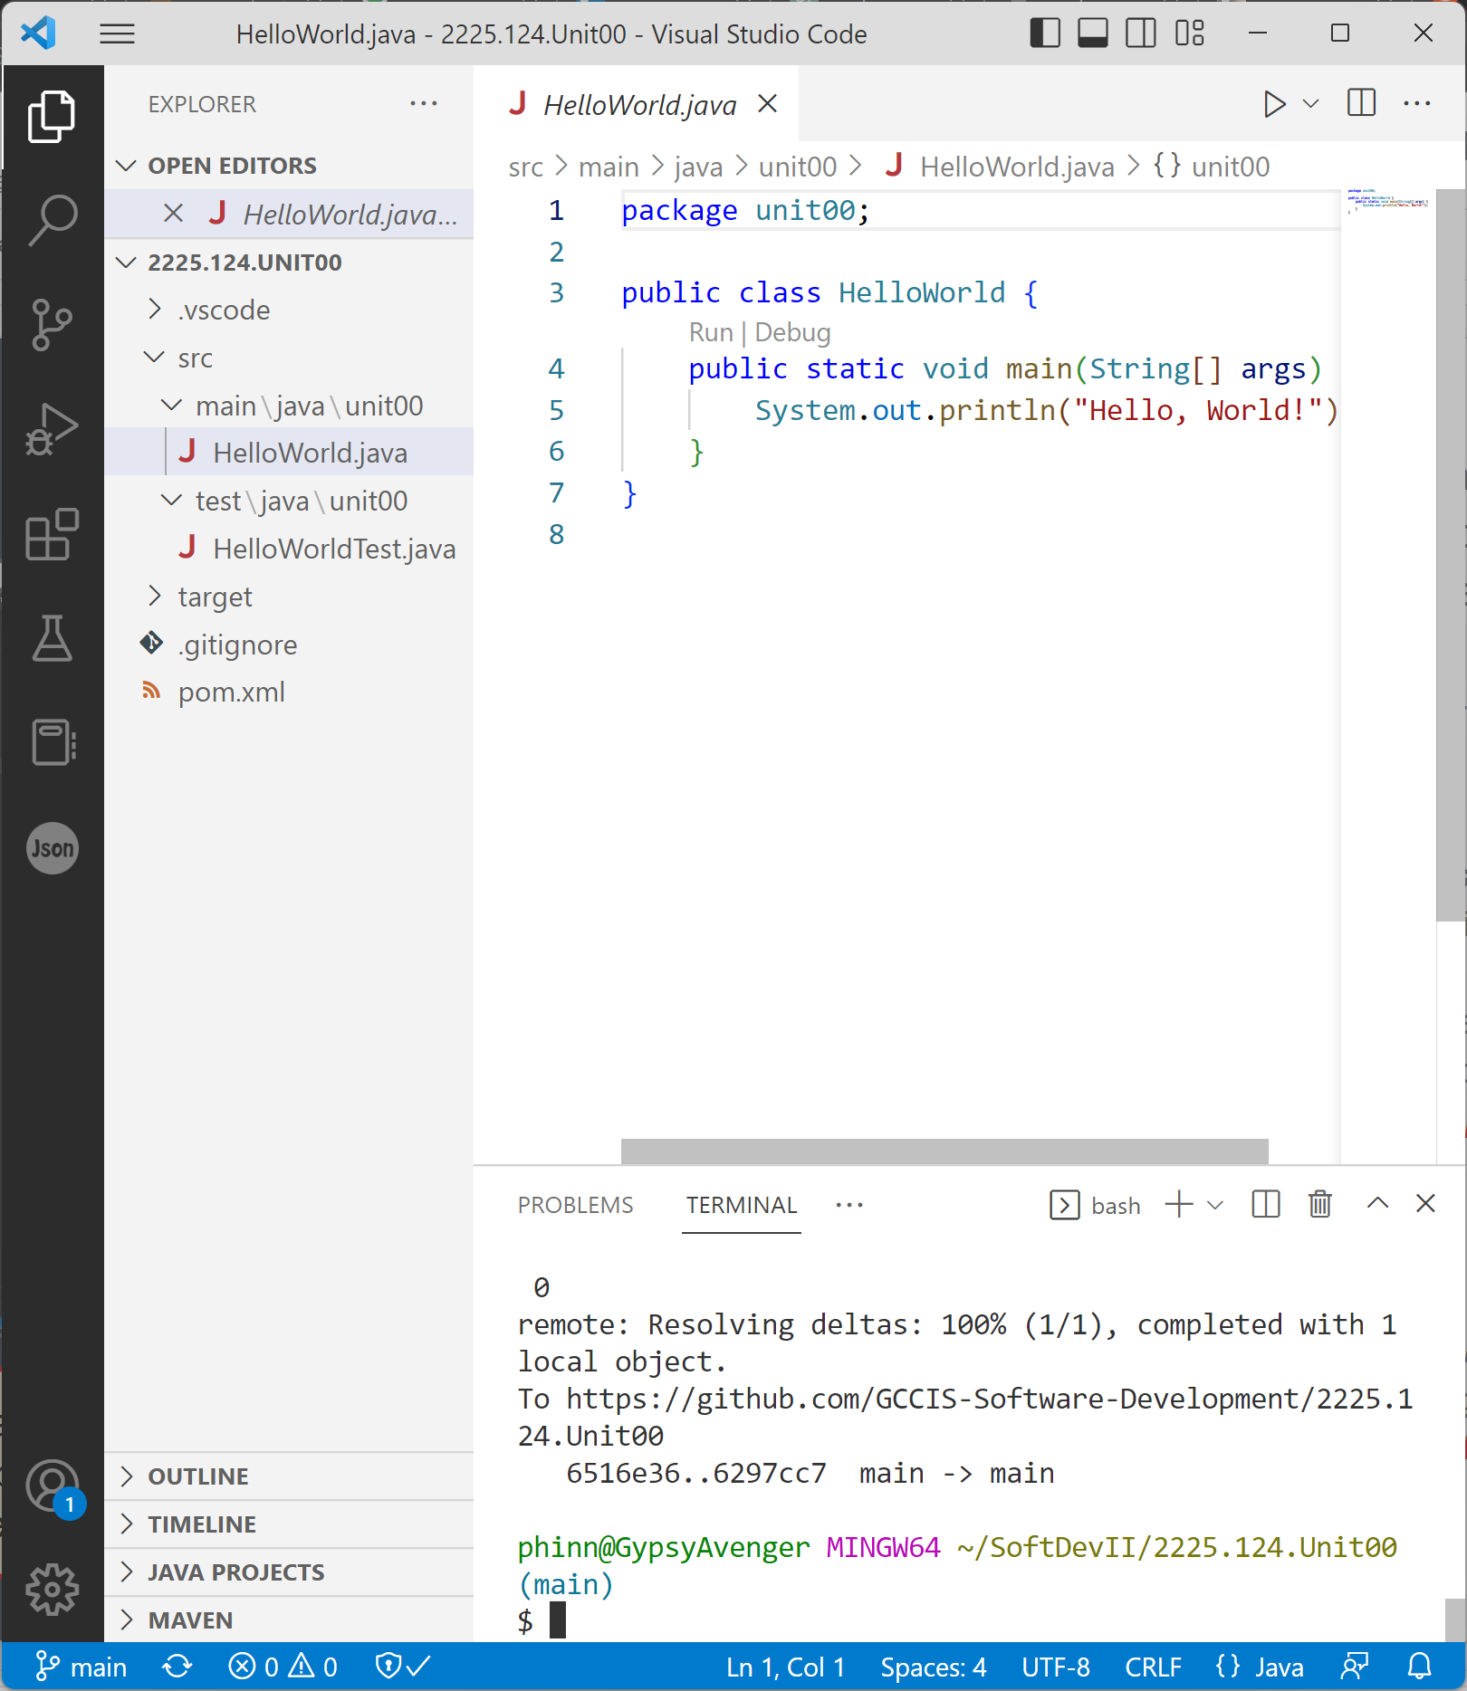
Exams
Throughout the semester you will take 3 midterm exams to assess whether or not you have sufficiently developed the expected skills up to that point in the semester.
Each midterm exam will focus on 3-4 units of material that were covered in class.
Each exam comprises two parts.
A practicum consisting of several small coding problems meant to assess your ability to solve computing problems using code.
A written portion designed to assess your comprehension of conceptual topics.
The midterm exams will each be worth 18% of your final grade; a total of 54%.
At the end of the semester, you will take a final exam.
The final will also consist of both written and practical components, weighted (40/60).
The final exam will be worth 21% of your final grade.
John Q. Student (jqs2312)
The mid-semester exams are not cumulative; each will focus on a specific series of units. The final exam will be cumulative.

Slide 14
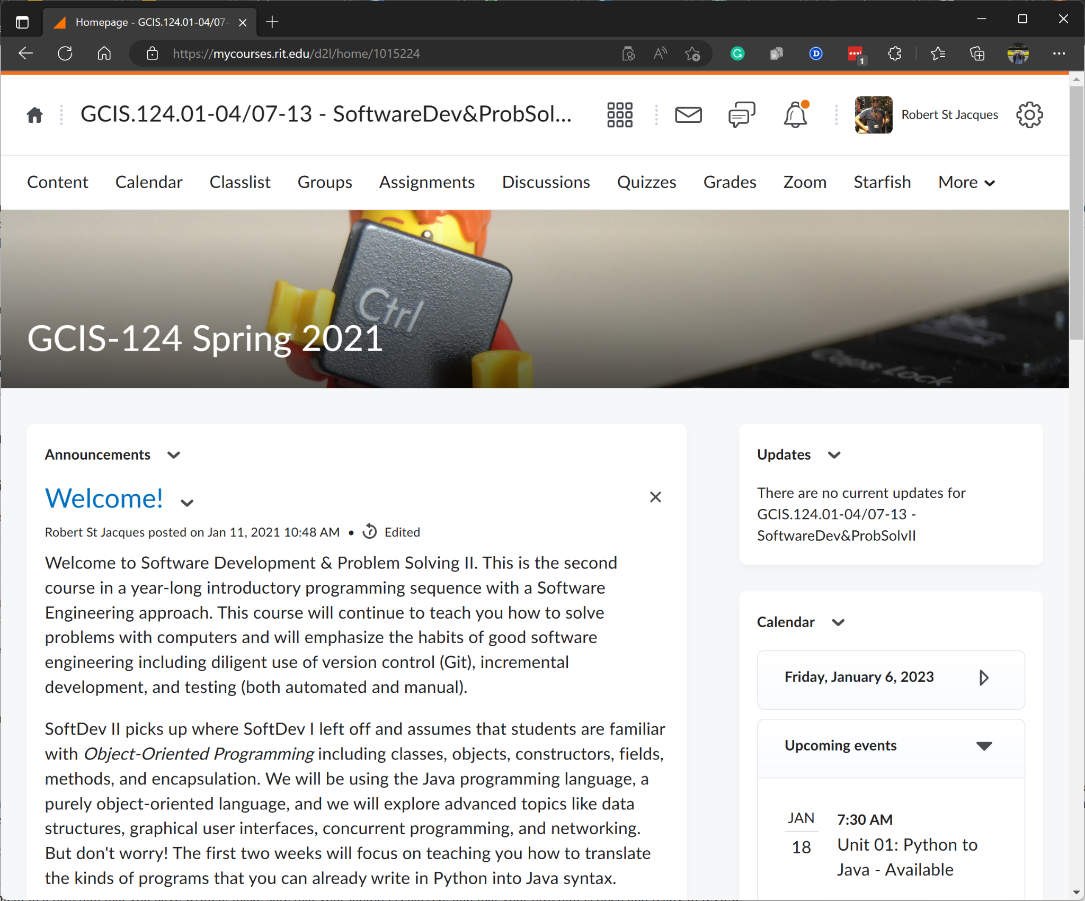
MyCourses
You will use MyCourses throughout the course for many important activities.
Important resources including links to GitHub Classroom, Discord, and more
Quizzes & Exams
Lecture Materials
Homework Assignments
Grades & Feedback
Announcements
You can also use MyCourses to find contact information
Your instructor
Course assistants
Fellow students
SIS
You will not use MyCourses to submit solutions to assignments or practicas.
Instead, you will simply push your code to GitHub before the deadline.
Your grader will pull the code directly from GitHub.
It's probably a good idea to spend a few minutes taking a quick tour of MyCourses now…

Slide 15
Grading Scheme
Letter Grade | % Range
A. | >= 92%
A- | >= 89%
B+ | >= 86%
B. | >= 82%
B- | >= 79%
C+ | >= 76%
C. | >= 72%
C- | >= 69%
D. | >= 59%
F. | < 59%
This course has an intentionally generous grading scheme with rounding already built in.
For example, in a typical grading scheme, an 89% would be considered a B+, but in Software Development & Problem Solving it is considered to be an A-.
While your instructor always has the final say, it is the course policy that grades are not rounded to the next higher grade.
e.g. an 88.9% is a B+, not an A-.
This would in effect be rounding the grade twice.
Given the number of students taking the course, the only way to be fair and equitable is to apply the same standards to everyone.

Slide 16
Academic Honesty
As members of an academic community, both students and faculty share responsibility for maintaining high standards of personal and professional integrity.
Collaborating with other students on the solutions to any individual assignment (including quizzes, homework assignments, mini-practicas, and exams) is cheating, and thus a violation of RIT’s Academic Integrity Policy.
“Over collaborating” involves sharing information at any level of detail that results in two or more students writing essentially identical solutions to all or part of an individual assignment.
If a violation of the academic integrity policy is suspected, the course faculty will conduct an investigation.
This will include an interview with the student(s) involved.
If the student(s) is/are found to have violated RIT’s Academic Integrity Policy, the penalty may include:
A zero grade on the assignment for a first minor offense.
A zero grade in the course for an egregious offense or a second minor offense.
Expulsion from your academic program.
Expulsion from the university.
You will presently be taking a quiz on this topic.

Slide 17
AI Code Generation
Using software tools to generate all or part of a solution to a homework assignment is a violation of the Academic Integrity Policy.
The penalty for each violation is a zero on the assignment.
Using software tools to generate all or part of a solution to a practical exam is considered an egregious violation of the Academic Integrity Policy.
The penalty for an egregious violation is an automatic F in the course, even if it is the first violation.
Students will be required to demonstrate a practical application of their programming skills during the mini-practica, midterm exams, and the final exam.
Students will be monitored by Course Assistants and their instructors during these exams.
Homework assignments are assigned to give students an opportunity to practice the skills that they will need to master to do well on their exams.
Students who rely on AI Code Generation to complete their homework assignments will be unprepared for their practical exams.

Slide 18
Academic Honesty Warning
Students who offer solutions or detailed information for assignments or exams bear the same level of responsibility as those who receive and submit such solutions.
If you are found to have breached the Academic Honesty policy on an exam or assignment, your previously submitted work, whether graded or ungraded, will be examined. Each assignment or exam that violates the Academic Honesty policy will be treated as a separate violation.

